Slide 1
Intel 8255 PPI
PPI – Programmable Peripheral Interface It is an I/O port chip used for interfacing I/O devices with microprocessor Very commonly used peripheral chip

Slide 2
PPI 8255
The 82C55 is a popular interfacing component, that can interface any TTL-compatible I/O device to a microprocessor.
It is used to interface to the keyboard and a parallel printer port in PCs (usually as part of an integrated chipset).
Requires insertion of wait states if used with a microprocessor using higher that an 8 MHz clock.
PPI has 24 pins for I/O that are programmable in groups of 12 pins and has three distinct modes of operation.

Slide 3
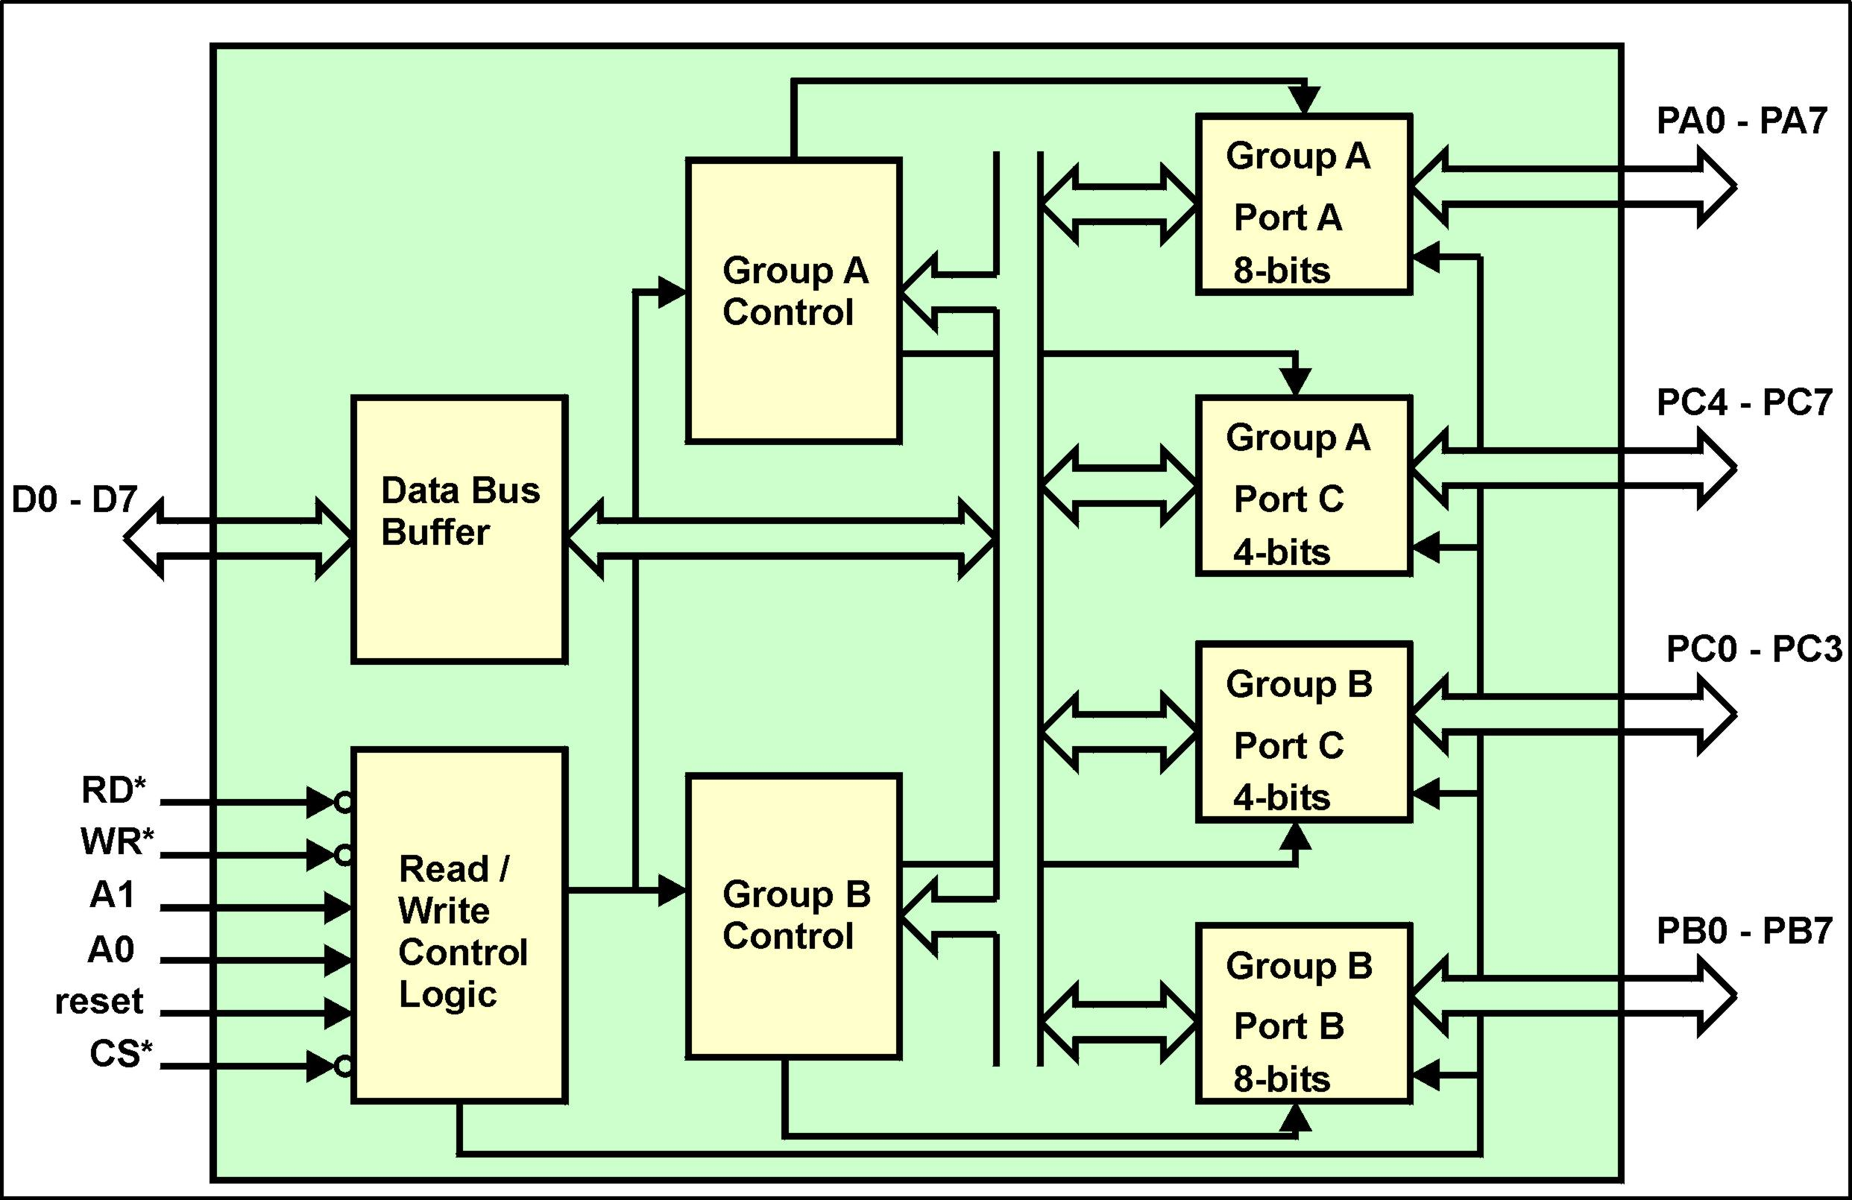

Slide 4
8255A Block Functions
Data Bus Buffers
  Are bi-directional tri-state buffers to interface the internal 8-bit bus of the 8255A to the system data bus.
Read/Write Control Logic
  The CS’ input is driven by the decoded address lines A2 - A7. The A1, A0 inputs identify any one of four internal registers. The reset input, when asserted, resets the 8255A to a default configuration (it is usually driven by the processors reset out control line).
  RD’ and WR’ specify the direction of data flow.
Ports
  There are four ports which can be configured as either input or output. Port A is an indivisible 8-bit port. Port B is an indivisible 8-bit port. Port C (upper) is an indivisible 4-bit port. Port C (lower) is an indivisible 4-bit port.

Slide 5
8255A Block Functions
Group Control Logic
  The group control logic block comprises registers that can be programmed by the processor and combinational circuitry whose configuration is a function of the controlling registers.
  The combinational circuitry controls the modes in which the ports operate.
  The group control logic is split into two similar subsytems - group A control which configures Port A and the upper 4-bits of Port C. group B control which configures Port B and the lower 4-bits of Port C.

Slide 6
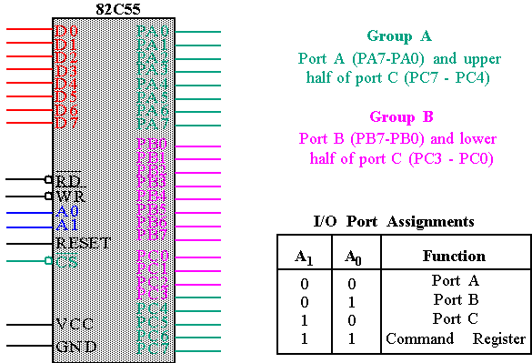
8255 : Pin Layout

Slide 7
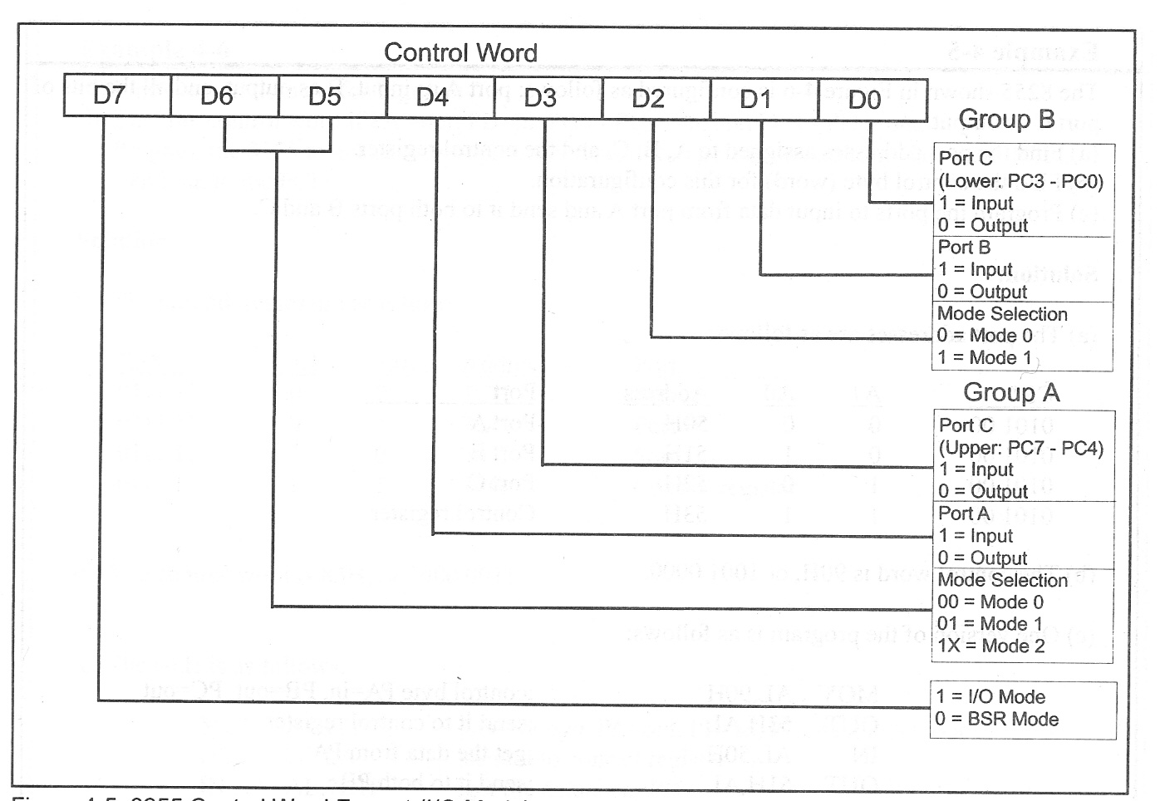
8255 Control Word

Slide 8
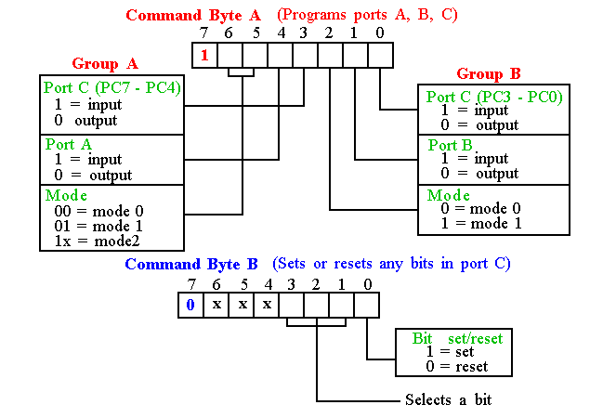
Programming 8255
8255 has three operation modes: mode 0, mode 1, and mode 2
11-<number>

Slide 9
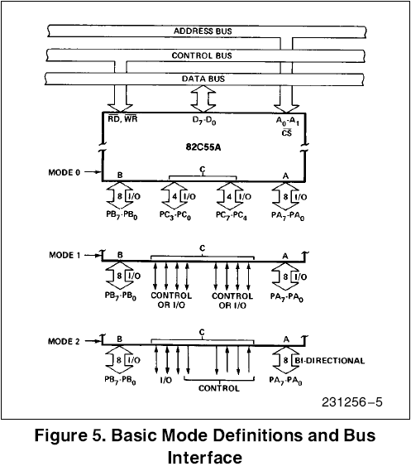
Basic Mode Definitions and Bus Int
Mode 0
  Basic I/O
Mode 1
  Strobe I/O
Mode 2
  Bi-Dir Bus

Slide 10
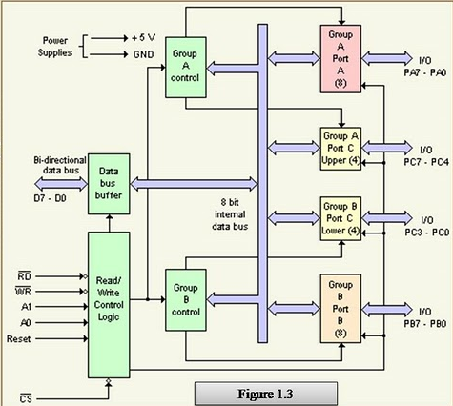

Slide 11
8255 PPI contd.
3 ports in 8255 from user’s point of view - Port A, Port B and Port C. Port C composed of two independent 4-bit ports - PC7-4 (PC Upper) and PC3-0 (PC Lower)
A1 | A0 | Selected port
0 | 0 | Port A
0 | 1 | Port B
1 | 0 | Port C
1 | 1 | Control port

Slide 12
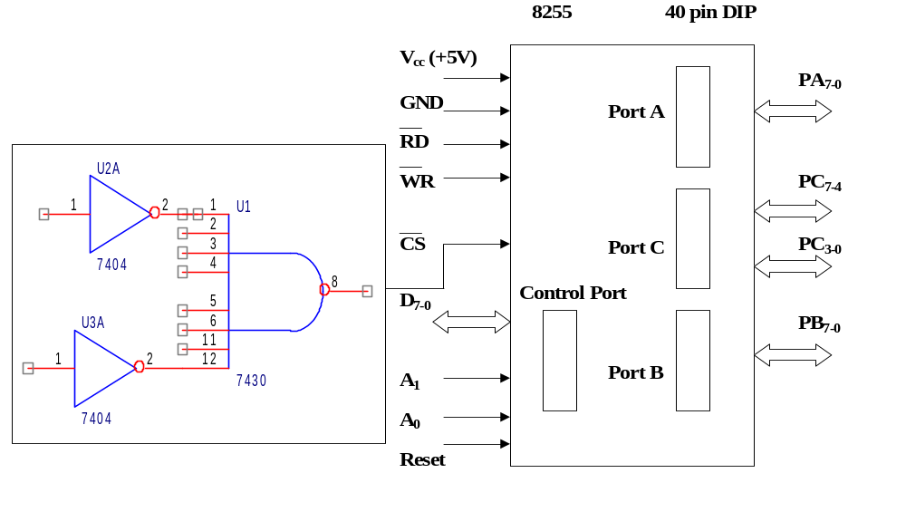
Intel 8255 PPI
Chip Select Circuit
A7
M/IO*
A7=0, A6=1, A5=1, A4=1, A3=1, A2=1, & M/IO*= 0

Slide 13
8255 PPI Contd.
There is also a Control port from the Processor point of view. Its contents decides the working of 8255. When CS (Chip select) is 0, 8255 is selected for communication by the processor. The chip select circuit connected to the CS pin assigns addresses to the ports of 8255. For the chip select circuit shown, the chip is selected when A7=0, A6=1, A5=1, A4=1, A3=1, A2=1, & M/IO*= 0 Port A, Port B, Port C and Control port will have the addresses as 7CH, 7DH, 7EH, and 7FH respectively.

Slide 14
8255 PPI Contd.
Mode 0: Simple Input or Output
In this mode, ports A, B are used as two simple 8-bit I/O ports
port C as two 4-bit ports.
Each port can be programmed to function as simply an input port or an output port. The input/output features in Mode 0 are as follows.
1. Outputs are latched.
2. Inputs are not latched.
3. Ports don’t have handshake or interrupt capability.

Slide 15
8255 PPI Contd.
Mode 1: Input or Output with Handshake
In this mode, handshake signals are exchanged between
the MPU and peripherals prior to data transfer.
The features of the mode include the following:
1. Two ports (A and B) function as 8-bit I/O ports.
They can be configured as either as input or output ports.
2. Each port uses three lines from port C as handshake signals.
The remaining two lines of Port C can be used for simple I/O operations.
3. Input and Output data are latched.
4. Interrupt logic is supported.

Slide 16
8255 PPI Contd.
Mode 2: Bidirectional Data Transfer
This mode is used primarily in applications such as data transfer
between two computers.
In this mode, Port A can be configured as the bidirectional port
Port B either in Mode 0 or Mode 1.
Port A uses five signals from Port C
as handshake signals for data transfer.
The remaining three signals from port C can be used either
as simple I/O or as handshake for port B.

Slide 17
8255 Handshake signals
Where are the Handshake signals? Port C pins act as handshake signals, when Port A and Port B are configured for other than Mode 0. Port A in Mode 2 and Port B in Mode 1 is possible, as it needs only 5+3 = 8 handshake signals After Reset of 8255, Port A , Port B , and Port C are configured for Mode 0 operation as input ports.

Slide 18
8255 Handshake signals Contd.
PC2-0 are used as handshake signals by Port B when configured in Mode 1. This is immaterial whether Port B is configured as i/p or o/p port. PC5-3 are used as handshake signals by Port A when configured as i/p port in Mode 1. PC7,6,3 are used as handshake signals by Port A when configured as o/p port in Mode 1. PC7-3 are used as handshake signals by Port A when configured in Mode 2.

Slide 19
8255 PPI Contd.
Port A can work in Mode 0, Mode 1, or Mode 2 Port B can work in Mode 0, or Mode 1 Port C can work in Mode 0 only, if at all Port A, Port B and Port C can work in Mode 0 Port A and Port B can work in Mode 1 Only Port A can work in Mode 2

